Slide 1

Introducing the miD-TERM EVALUATION OF CZECHIA’S sme SUPPORT STRATEGY: 2021-2027
An OECD project in collaboration with Czechia’s Ministry of Industry and Trade and with support from the European Commission - DG REFORM
Czechia’s National SME policy workshop
Organised by Ministry of Industry and Trade
7 May 2024
Marco Marchese, Policy Analyst and Project Coordinator
OECD Centre for Entrepreneurship, SMEs, Regions and Cities
marco.marchese@oecd.org

Slide 2
Outline of the presentation
Introduction of the project
Czechia’s SMEs at a glance
Q&A

Slide 3

Introduction of the project

Slide 4
Background information of the project
The Czech Ministry of Industry and Trade requested support for the “Mid-term evaluation of the National SME Support Strategy, 2021-2027” under the 2024 cycle of the Technical Support Instrument (TSI) regulation (October 2023).
The application was selected for funding in January 2024.
The Ministry of Industry and Trade has proposed that the OECD undertakes this evaluation exercise.
The project will have a duration of 12 months, starting from June or July 2024, depending on final approval by OECD and DG REFORM legal teams.

Slide 5
Timeline of the project (two options)
Project is approved in May for start on 7 June | Project is approved later in July
7-8 June 2024: Internal kick-off meeting | July 2024: Internal kick-off meeting
24-28 June: One-week OECD fact-finding mission to Prague | 9-13 Sept.: One-week OECD fact-finding mission to Prague
July-Dec. 2024: Preparation of the first draft report | Sept.-Dec. 2024: Preparation of the first draft report
Jan.-Feb. 2025: Comments from the Czech government. | Jan.-Feb. 2025: Comments from the Czech government.
Mar.-Apr. 2025: Finalization of the report | Mar.-Apr. 2025: Finalization of the report
May 2025: Final dissemination workshop | May 2025: Final dissemination workshop

Slide 6
Key policy areas to cover
Business environment
Access to financing
Access to markets
Workforce, skills and education
Research, development and innovation
Digitalization
Low-carbon economy and resource efficiency

Slide 7
Main expected outputs of the project
Mid-term evaluation report, inclusive of Action Plan, supporting the remaining implementation period of the strategy and beyond
Final dissemination workshop

Slide 8

Czechia’s SMEs at a glance across the policy areas of the SME Support Strategy

Slide 9
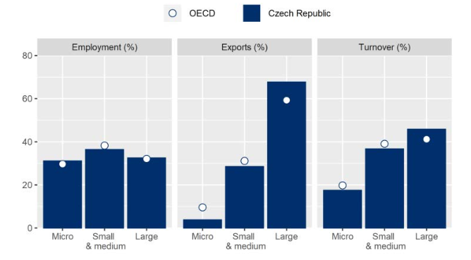
SME account for two-thirds of national employment, but lower shares of exports and turnover.
Figure. SME share of employment, exports and turnover in Czechia, 2020
OECD (2023), OECD SME and Entrepreneurship Outlook 2023, OECD Publishing, Paris, https://doi.org/10.1787/342b8564-en

Slide 10
SME labour productivity has increased, but gaps with large companies have not receded
Figure. Labour productivity trends in Czechia by firm size, 2020 and 2010
CZK Mil.
OECD Structural Demographics and Business Statistics (SDBS), 2023

Slide 11
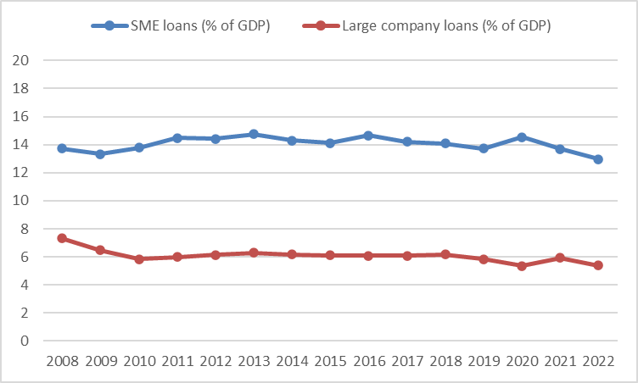
SME loans have been stable over time, although there has been a recent decline since 2020.
Figure. SME loans and large-company loans in Czechia, 2008-2020
%
OECD (2024), Financing SMEs and Entrepreneurs 2024: An OECD Scoreboard, OECD Publishing, Paris, https://doi.org/10.1787/fa521246-en.

Slide 12
SME interest rates increased considerably in 2022, although the spread declined
Source: OECD (2024), Financing SMEs and Entrepreneurs 2024: An OECD Scoreboard, OECD Publishing, Paris, https://doi.org/10.1787/fa521246-en.

Slide 13
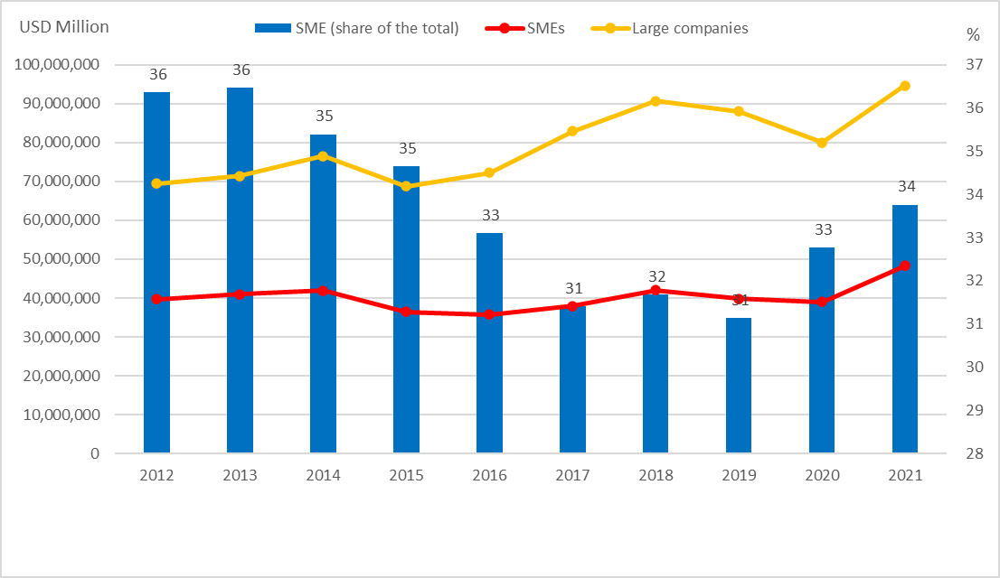
SMEs account for about one-third of total direct exports in Czechia
Figure. SME export volumes and share of the total, Czechia, 2012-2021
Source: OECD “Trade in goods by enterprise characteristics” database.

Slide 14
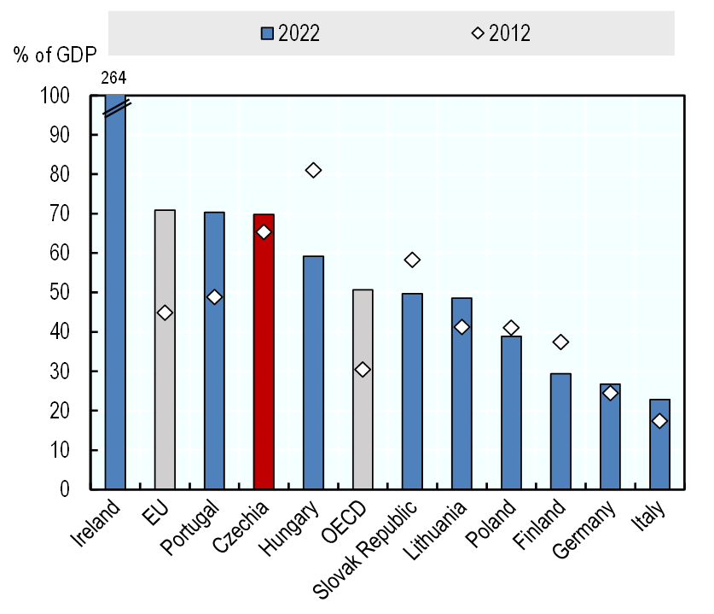
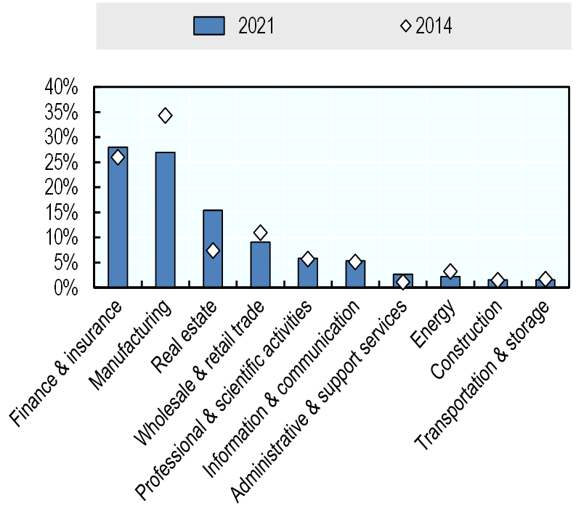
FDI plays an important role in the Czech economy, leaving room for SME indirect exports
A. Inward FDI stock as a share of GDP
B. Inward FDI by sector (% of the total)
Source: OECD International Direct Investment Statistics, http://www.oecd.org/investment/statistics.htm, Czech National Bank (2023), FDI positions in the Czech Republic, https://www.cnb.cz/cs/statistika/

Slide 15
Czech SMEs provide on-the-job training to their employees, but access to skills remains a challenge
Figure. On-the-job training and skills development in Czech SMEs, 2020 and 2022
Source: Eurostat (2020_{[22]}), Continuing Vocational Training in Enterprises Survey, https://ec.europa.eu/eurostat, and World Bank Enterprise Surveys (2022), www.enterprisesurveys.org

Slide 16
Czech SMEs account for about one-quarter of business R&D
Figure. Distribution of business R&D by firm size, 2020
Source: OECD Research and Development Statistics Database, 2021

Slide 17
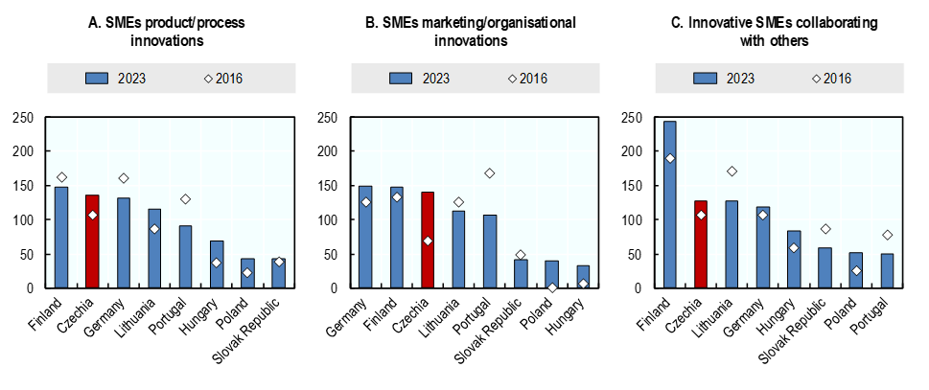
Nonetheless, Czech SMEs’ innovation performance has improved in more recent years
Figure. SME innovation performance (index, 100 = EU average)
Source: OECD Research and Development Statistics Database, 2021

Slide 18
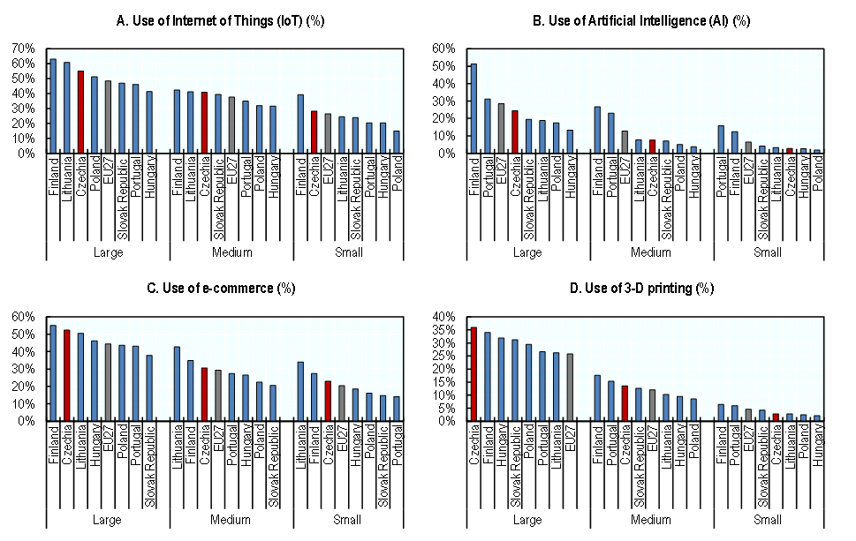
Nonetheless, Czech SMEs’ innovation performance has improved in more recent years
Figure. The use of digital technologies by Czech SMEs, 2021
Source: OECD ICT Access and Usage by Businesses Database

Slide 19
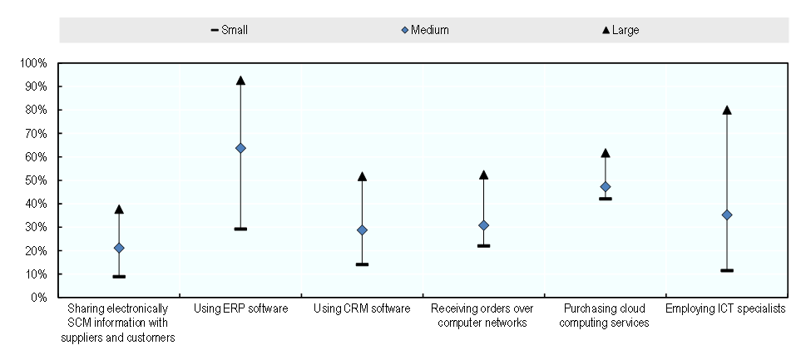
The digital gap between large firms and SMEs is wider in supplier and customer management technologies
Figure. SME use of supplier and customer management technologies, 2021
Source: OECD ICT Access and Usage by Businesses Database

Slide 20
Czech SMEs account for a relevant share of business-driven GHG emissions
Figure. SME share of GHG emissions in the business sector, 2018
Source: OECD (2023), "Assessing greenhouse gas emissions and energy consumption in SMEs: Towards a pilot dashboard of SME greening and green entrepreneurship indicators", OECD SME and Entrepreneurship Papers, No. 42, OECD Publishing, Paris, https://doi.org/10.1787/ac8e6450-en.

Slide 21
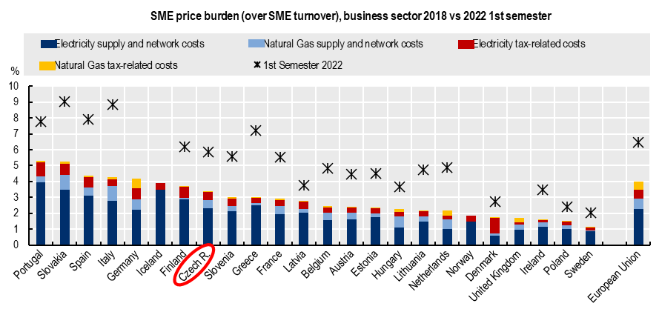
The energy crisis had a major impact on SME turnover in Czechia as much as in the rest of Europe
Figure. SME energy price burden, 2018 and 2022
Source: OECD (2023), "Assessing greenhouse gas emissions and energy consumption in SMEs: Towards a pilot dashboard of SME greening and green entrepreneurship indicators", OECD SME and Entrepreneurship Papers, No. 42, OECD Publishing, Paris, https://doi.org/10.1787/ac8e6450-en.

Slide 22

Questions & Answers

Slide 23
Thank you!
Marco.marchese@oecd.org

