Slide 1

Strategic Technologies for Europe Platform (STEP)
STEP Seminar
Irati ICARDO ISASA & Benoit ESMANNE - STEP Team– DG BUDG – EUROPEAN COMMISSION
https://strategic-technologies.europa.eu

Slide 2
In a nutshell
STEP
Not a new fund: pooling funding from 11 EU existing programmes, with a top-up of €1.5bn for defence
Efficient: use of existing networks/processes
Articulation direct/indirect/shared managed funds
STEP Seals awarded to high-quality projects
A service-oriented team to support STEP sectors
User-centric portal
A pilot for a new Competitiveness Fund as announced by Commission President
Regulation entered into force on 1 March 2024

Slide 3
Mobilising funds towards STEP

Slide 4

11 EU programmes support STEP
STEP
More than 100 calls €13.5bn
€14bn across 21 MS
5
6
EU PROGRAMMES⁽¹⁾
EU PROGRAMMES
Funding and STEP Seal awarded by the Commission
Funding allocated by Member States from the EU budget and financial institutions (e.g., EIB)
Horizon Europe⁽²⁾ | EU4 Health
Innovation Fund | European Defence Fund
Digital Europe Programme
Award of
STEP Seal
European Regional Development Fund | Cohesion Fund
European Social Fund + | Just Transition Fund
Recovery & Resilience Facility⁽³⁾ | InvestEU⁽⁴⁾
PROJECTS' FAST TRACK TO OTHER FUNDING
⁽¹⁾ Direct management: EU funding is managed directly by the Commission; shared management: the European Commission and national authorities jointly manage the funding; indirect management: funding is managed by partner organisations or other authorities inside or outside the EU
⁽²⁾ European Innovation Council
⁽³⁾ Performance based programme managed by the European Commission and implemented by the Member States
⁽⁴⁾ Implemented through the EIB group & other implementing partners – not awarding the Seal
Notes:
RRF: MS can allocate more support from RRF to InvestEU for STEP (additional 6% and up to 10% of their plans) - Deadlines shift to end 2028 for the implementation
Projects awarded the Seal to be considered in revision
OK with the slide with one request:
Put in a different color those funds which are sepcfiic to a sector: EU4Health, Innovation Fund, DEP
WHen presenting, do stress that:
-all these are funded by the EU budget with programmes on the left (managed directly by COM) much less endowed than those on the right (mostly managed with MS)
-we are aware of the complexity of the galaxy of funds today
-On the left, programmes are EU-wide, the best projects wins for the benefit of the Single Market as a whole. On the right, except for InvestEU, the envelope is allocated ithn each MS.
-How much PT is getting in cohesion funds and in RRF (loans + grants) that is then allocated by the Member STate according to common rules – do check for your backgrouind the state of play on RRF implementation in PT

Slide 5
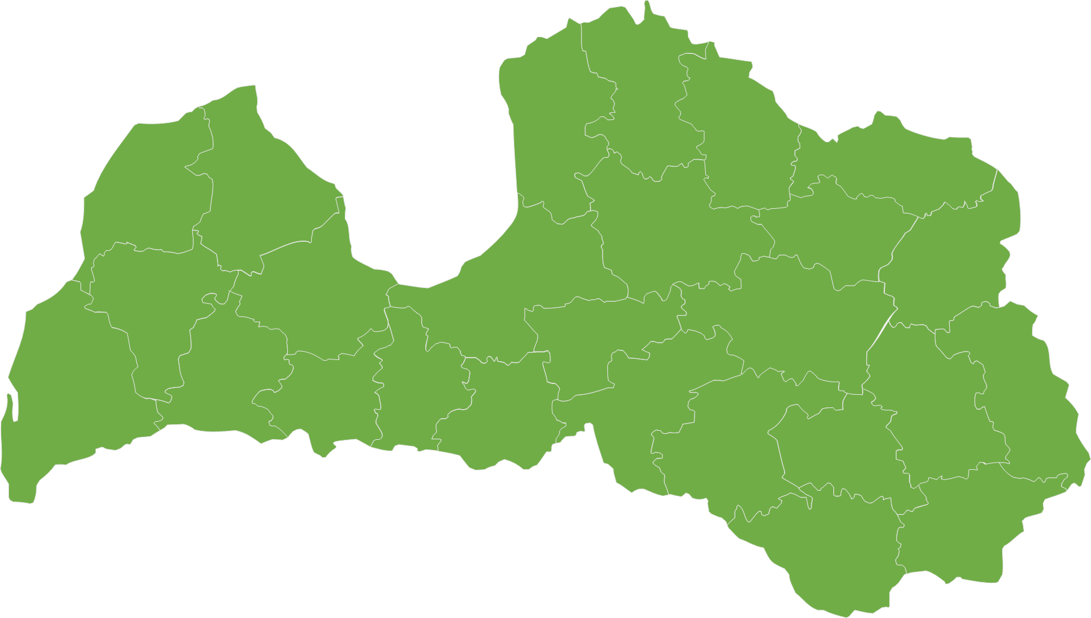
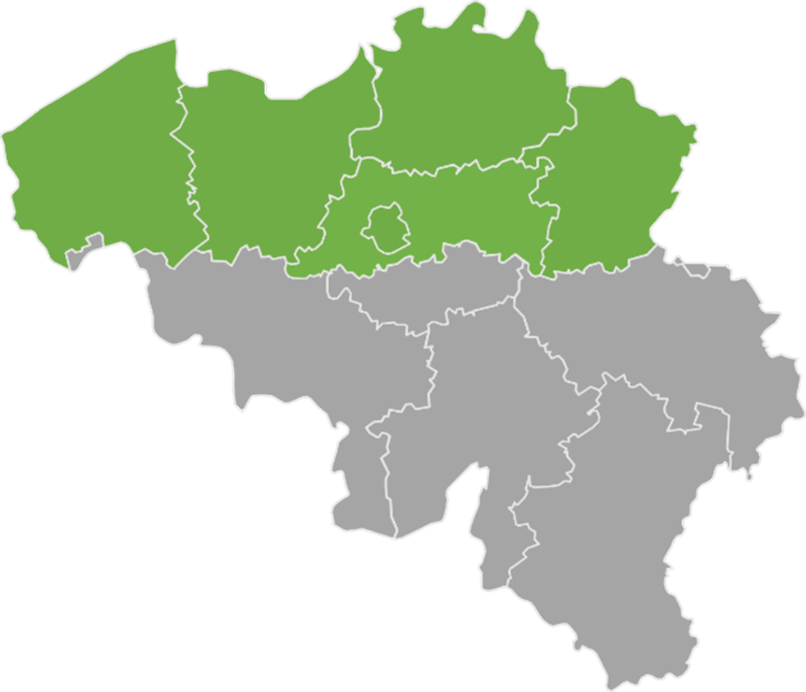
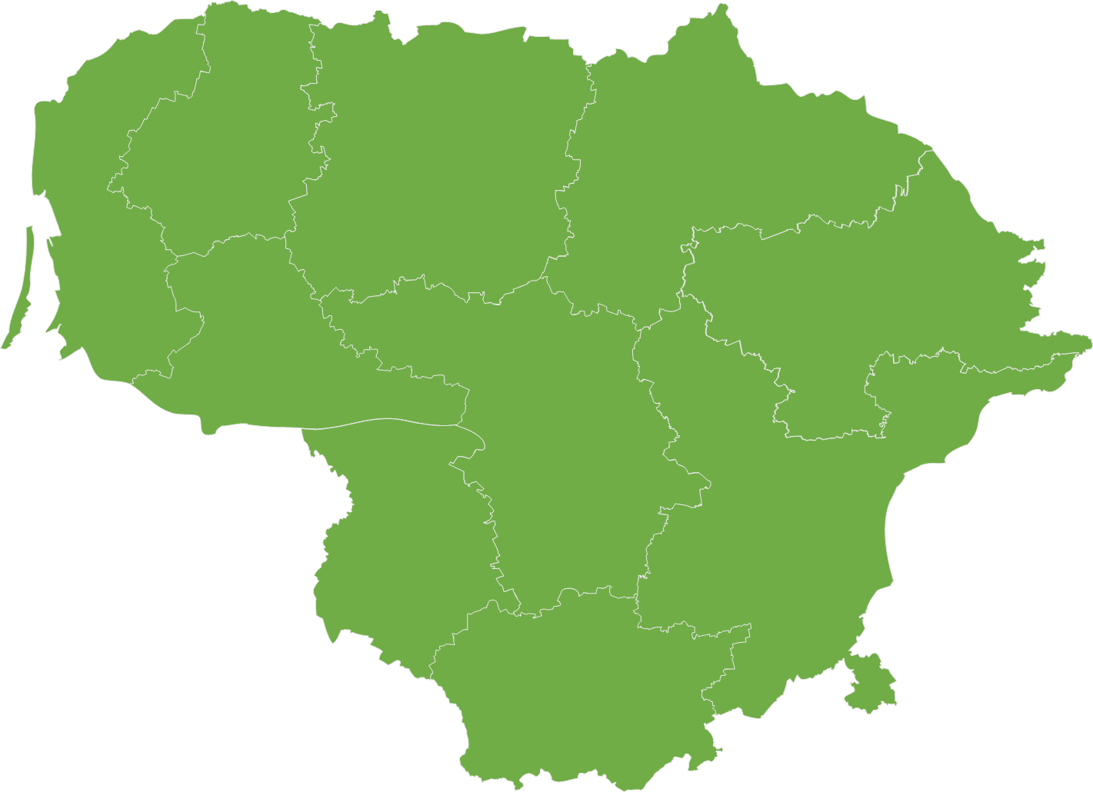
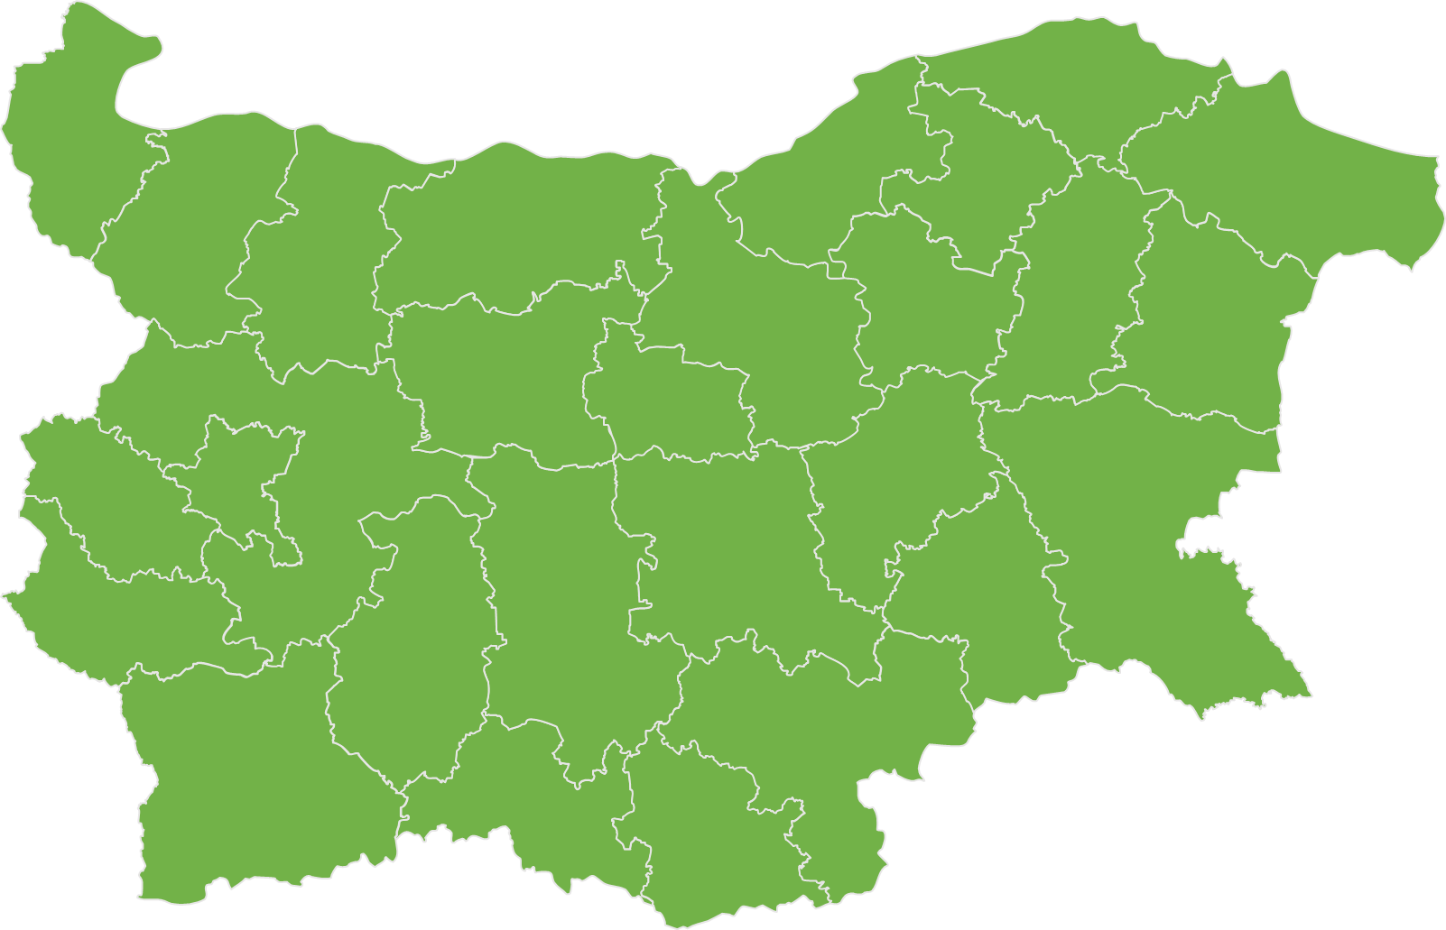
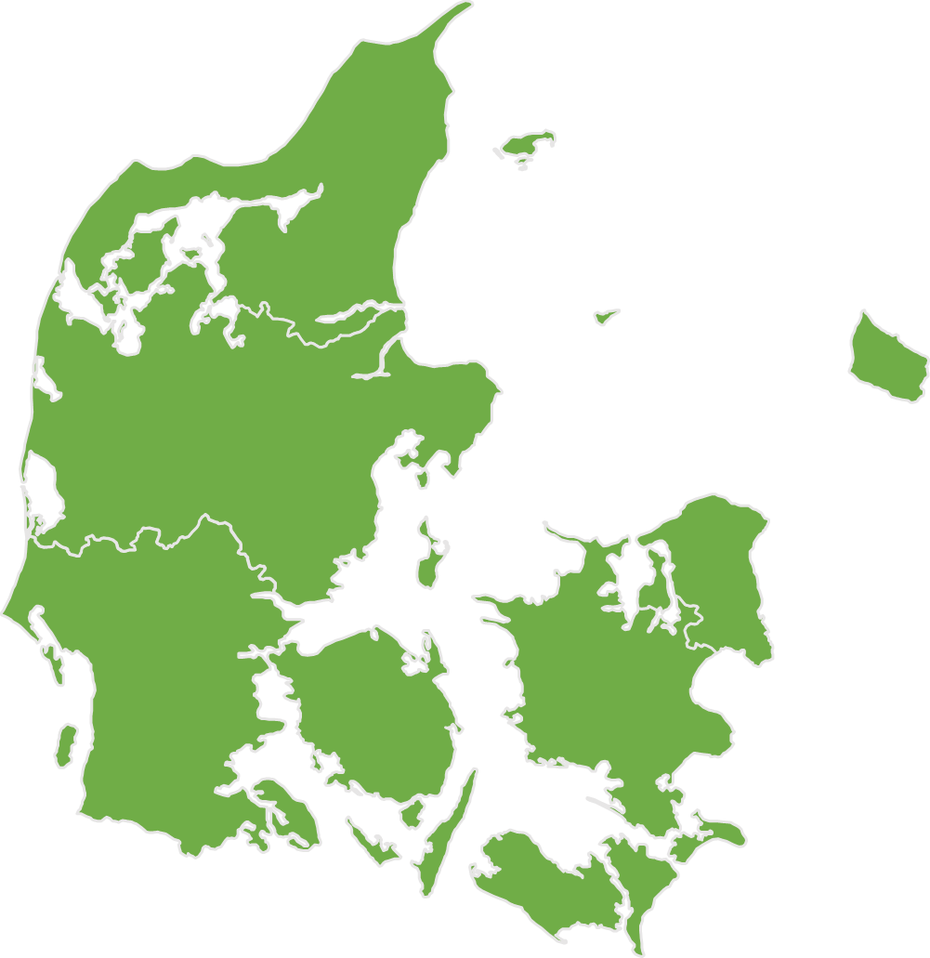
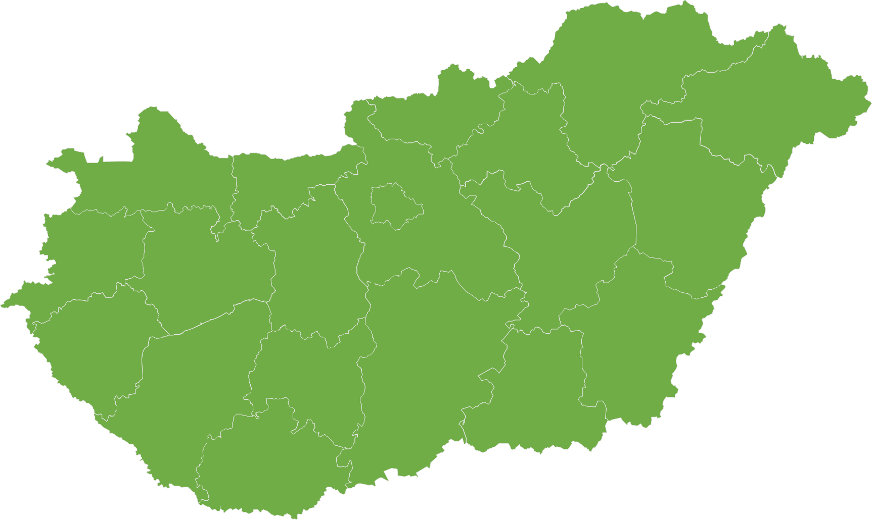
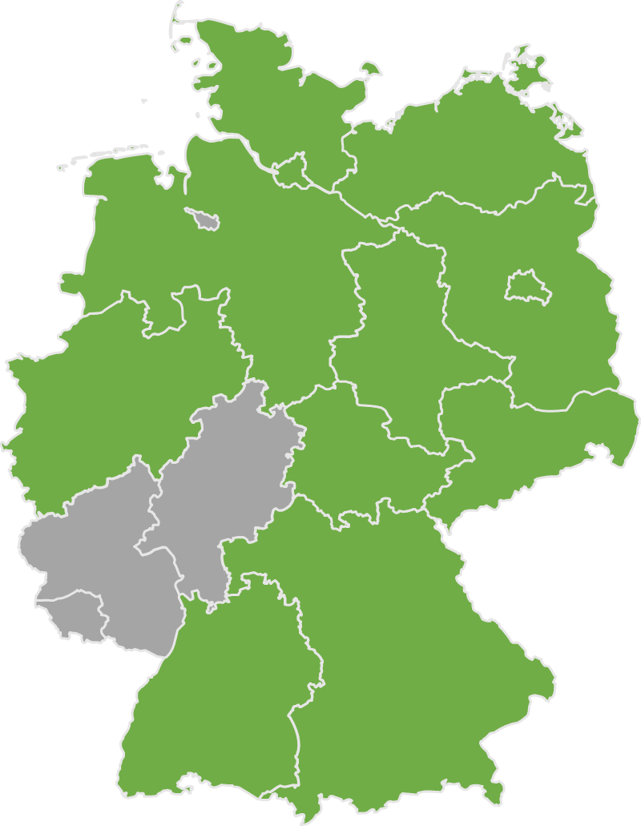
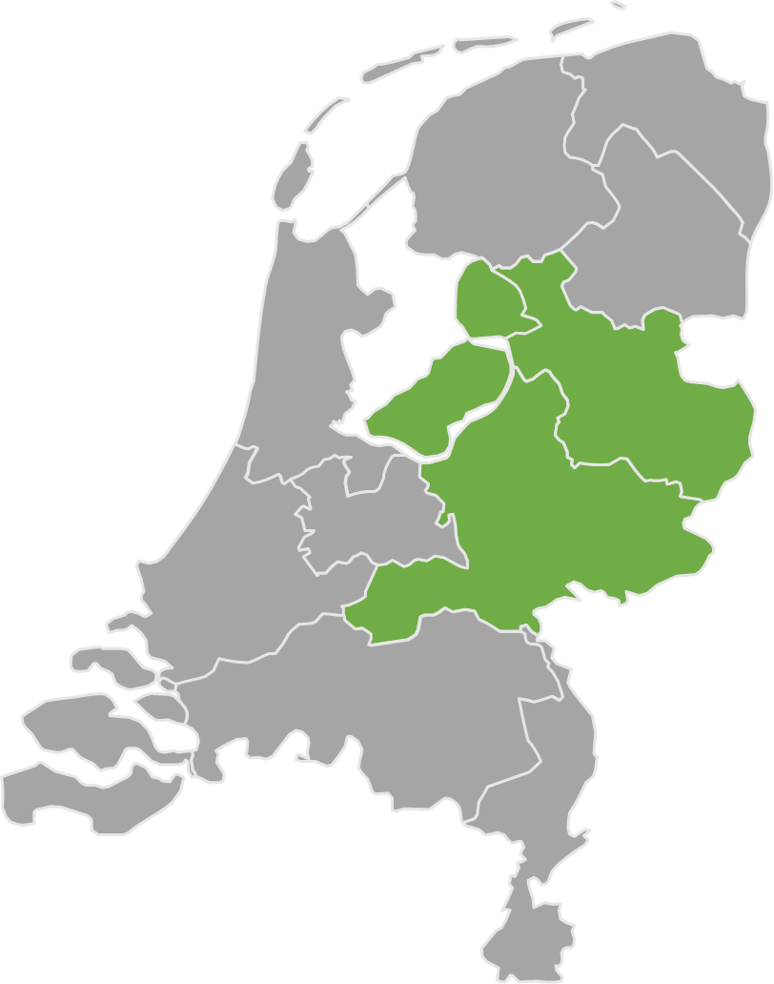
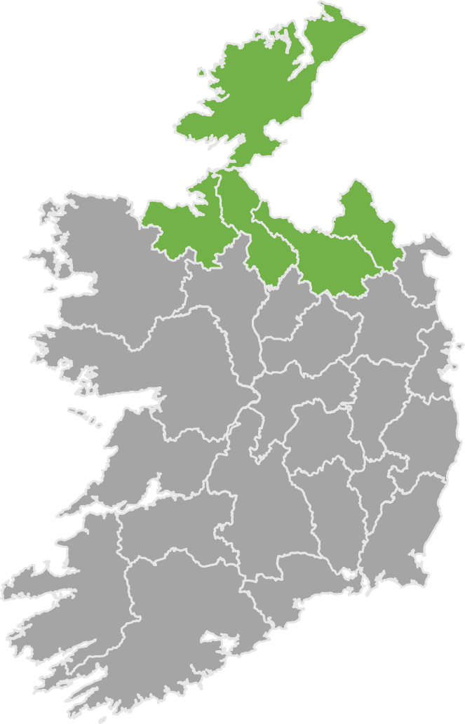
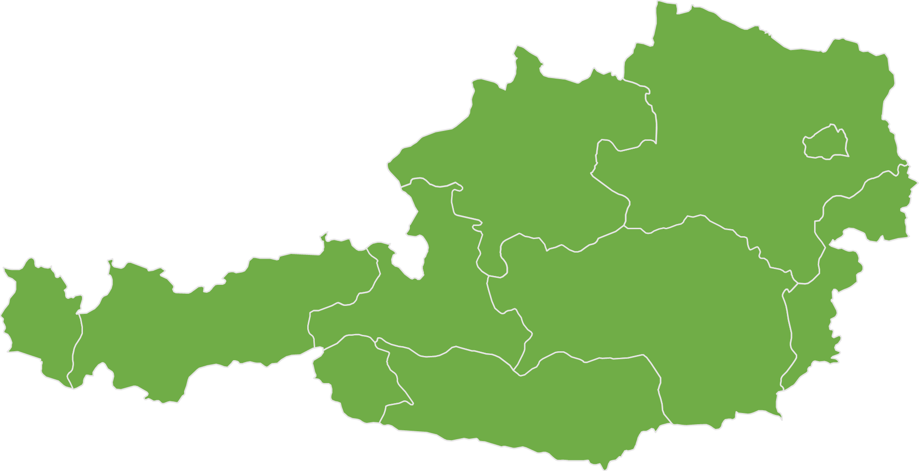
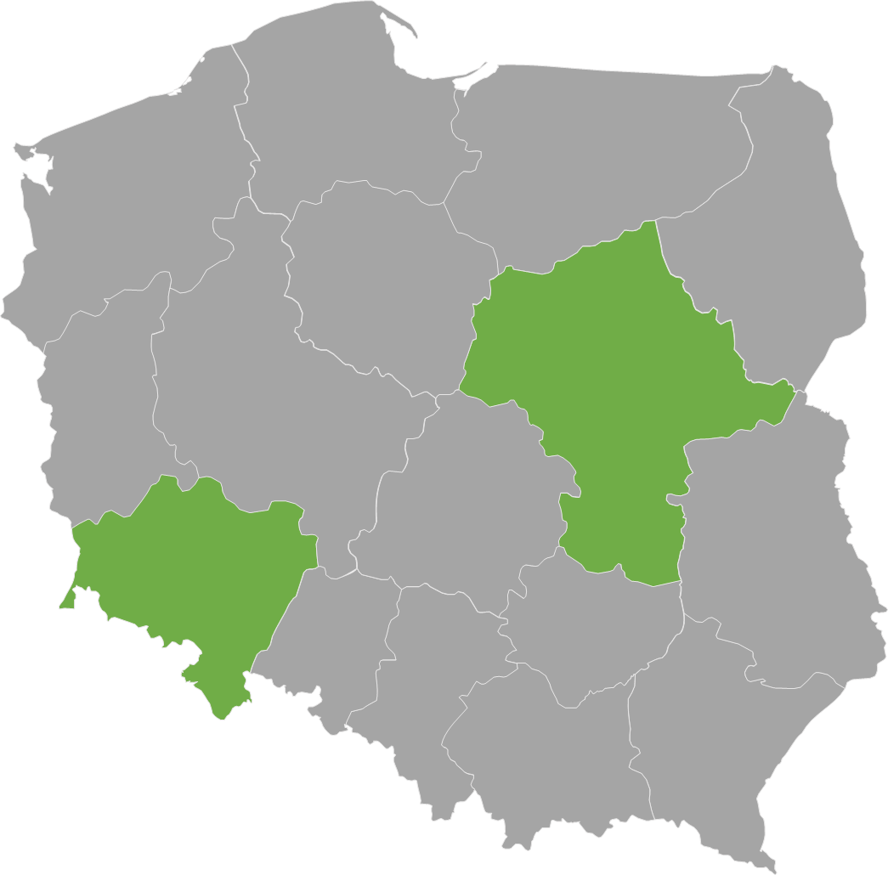
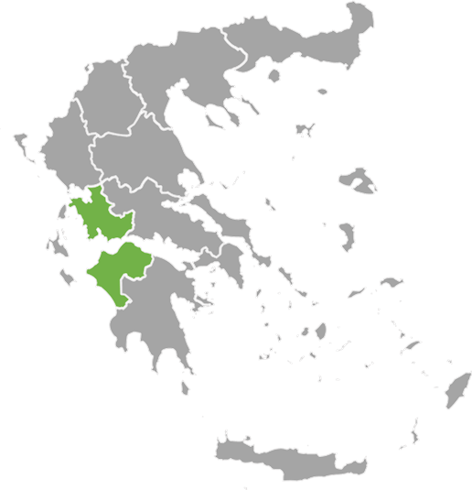
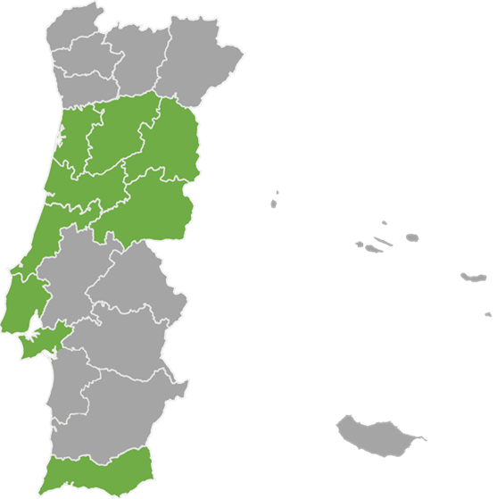
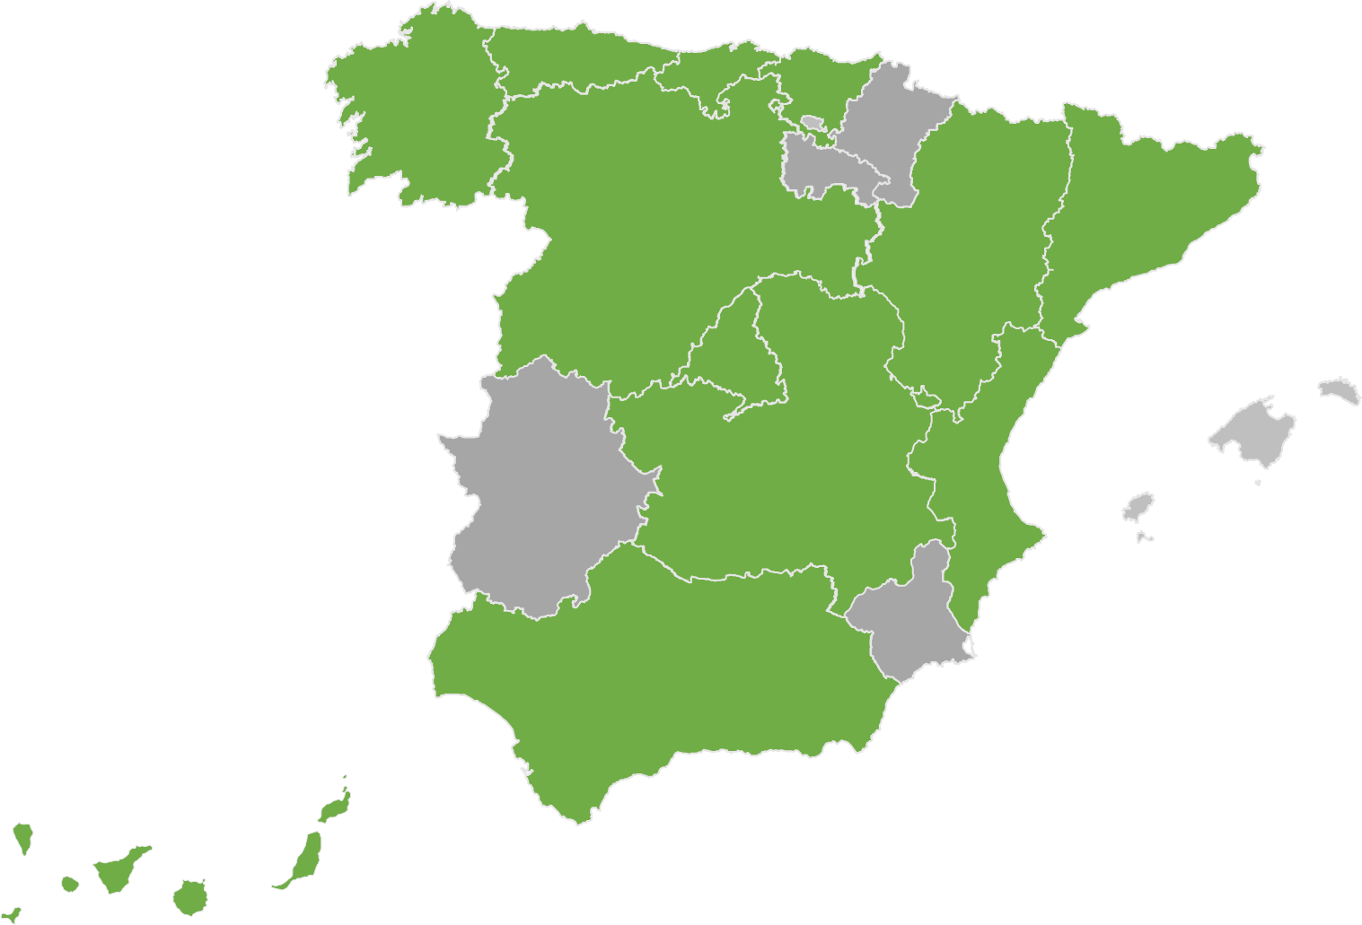
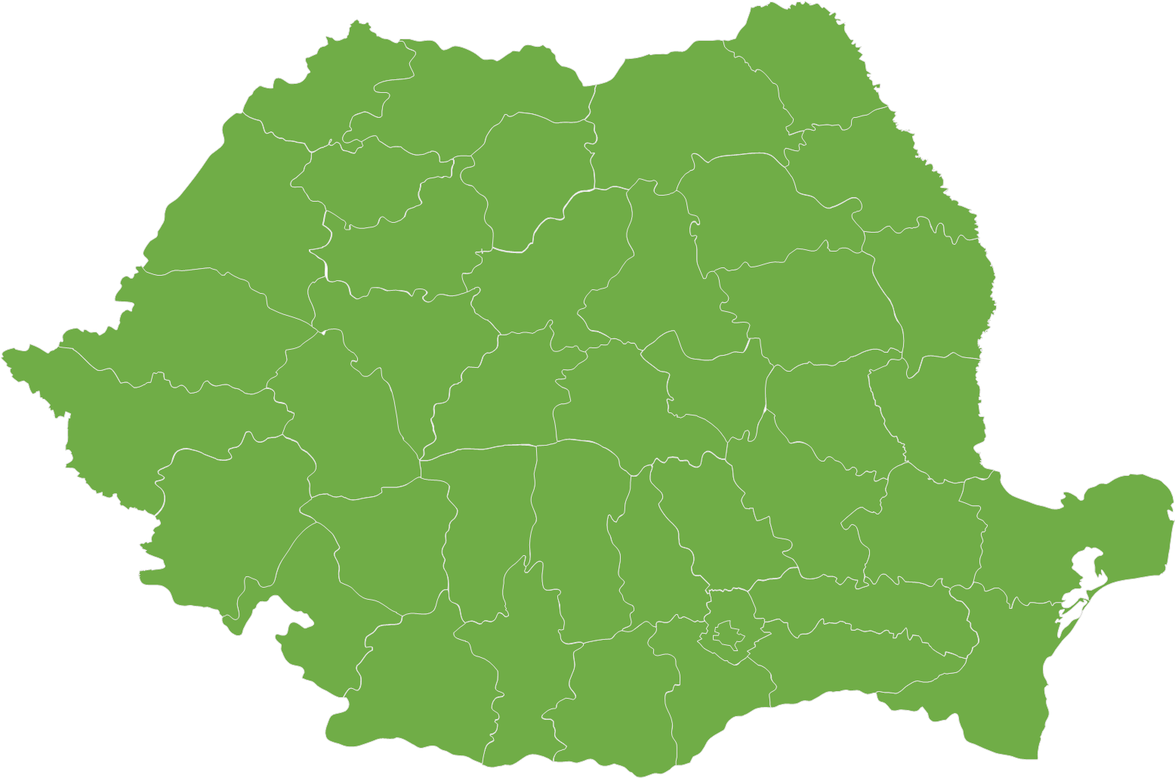
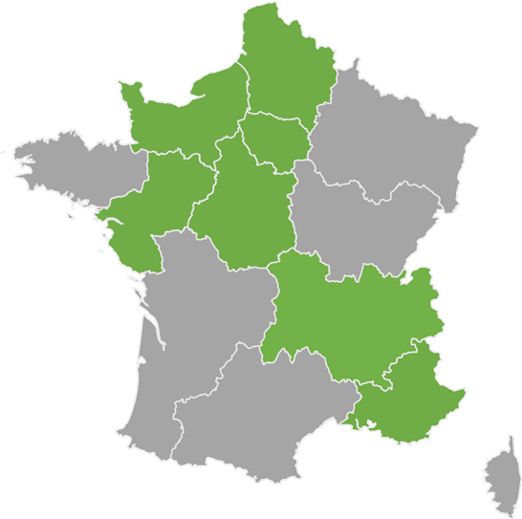

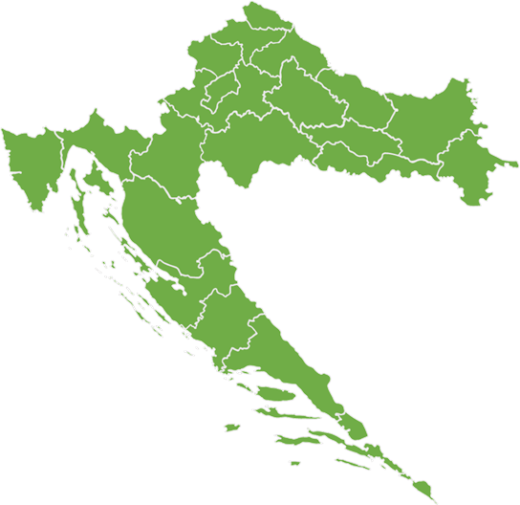
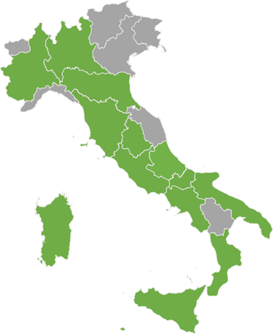
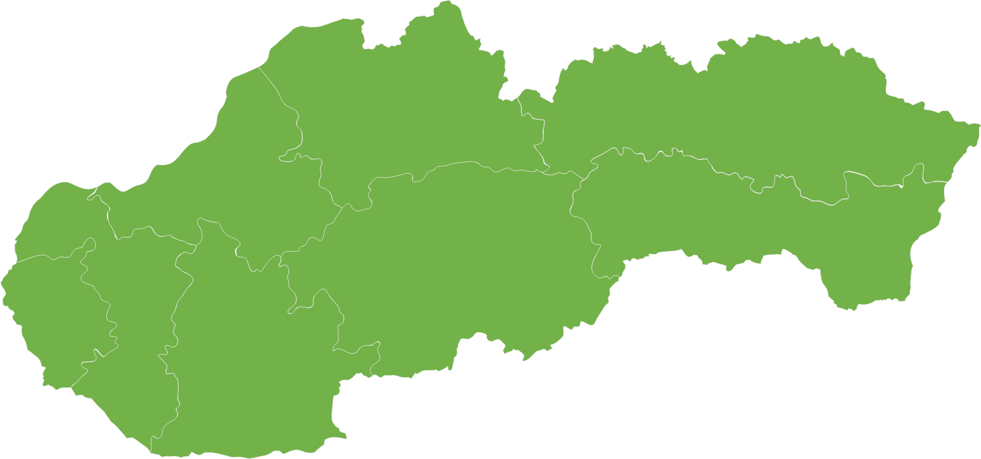
Design Suggestion
STEP Funding under Cohesion Policy (31.12.25)
Latvia – EUR 58m
Belgium – EUR 70m
1 national ERDF programme
2 regional ERDF programmes
EUR 13.7 bn allocation to STEP adopted
Lithuania – EUR 59m
Bulgaria – EUR 161m
1 national ERDF programme
2 national ERDF programmes
Hungary – EUR 545m
Denmark – EUR 65m
1 national ERDF and 1 national ERDF/ESF+ programme
1 national JTF programme
Germany – EUR 1.6 bn
Netherlands – EUR 20m
1 regional ERDF and 1 national JTF programme
12 regional ERDF, 1 regional JTF and
1 regional ESF+ programmes
Austria – EUR 18m
Ireland – EUR 2m
1 national JTF programme*
1 regional ERDF programme
Poland – EUR 956m
Greece – EUR 334m
2 regional and 1 national ERDF programmes
2 national ESF+, 1 National JTF and ERDF and 1 regional ERDF programme
Portugal – EUR 1.3bn
Spain – EUR 1.9 bn
3 regional and 1 national ERDF programmes
13 regional and 1 national ERDF, 6 regional ESF+ and 1 national JTF programmes
Romania – EUR 1.8bn
8 regional and 2 national ERDF, 1 national ESF+, 1 national JTF programmes
France – EUR 214m
Adopted programmes
7 regional multifund programmes
Slovenia – EUR 103m
Italy – EUR 4.2bn
1 national ERDF programme
Croatia – EUR 198m
13 regional and 1 national ERDF, and 2 national and 2 regional ESF+ programmes
Slovakia – EUR 232 m
2 national ERDF programmes
1 national ERDF programme

Slide 6
STEP Scope
Objectives, conditions, and scope

Slide 7
Scope
STEP
STEP
OBJECTIVES
STEP
CONDITIONS
STEP
SECTORS
(indicative & non-exhaustive)
EXAMPLES
Supporting the development or manufacturing of critical technologies or safeguarding and strengthening their respective value chains | Bring an innovative, cutting-edge element with significant economic potential to the Single Market
Addressing shortages of labour and skills | Contribute to reduce or prevent strategic dependencies of the Union
Digital and deep tech innovation | Artificial intelligence, quantum technologies, advanced connectivity
Clean and resource efficient tech | Carbon capture and storage technologies, heat pumps
Bio tech | Molecular biotechnology, pharmaceuticals, crop biotechnology
Defence | All defence technologies, including dual-use
CRMA
NZIA
OR
NEW
*STEP Guidance notes published on 13 May 2024 and 23 December 2025
NZIA: Net-Zero industry Act
CRMA: Critical Raw Materials Act

Slide 8
Development and manufacturing in the EU
STEP OBJECTIVES
Skills that are relevant to the development and manufacturing of critical technologies.
Broader and transferable skills may only be supported via STEP if they are combined with STEP-specific skills (these skills on their own do not qualify as a STEP project.). Fund-specific rules apply.
TRL levels are indicative
Skills
TRL4 | TRL5 | TRL6 | TRL7 | TRL8 | TRL9
Fundamental research
(incl. TRL1-3)
Installation and deployment of the final products*
Development
Manufacturing
Activities aimed at achieving technological breakthroughs, perfecting the technology for market needs, including enhancing its efficiency, reliability, and developing standards.
Setting up production lines, first-of-a-kind-facilities, the extension or repurposing of existing facilities, scaling up processes to meet demand, and/or implementing quality control mechanisms to ensure the consistent production of high-quality products.
Unless:
Associated service
First-of-a-kind facility
Associated services are specialised services critical and specific to the development and manufacturing of final products in STEP sectors.
Ancillary services may only be supported via STEP if they are an inherent part of the investment cost of a STEP project (no standalone project). Fund-specific rules apply.
*Final products = completed technological solutions that emerge from the entire process of development and manufacturing
Notes:
First-of-a-kind facility refers to a manufacturing or production facility that, in its design and operation, demonstrates innovative and new technologies or processes. These facilities are characterised by the use of emerging or advanced technologies that have not been widely commercially deployed, either in the EU or globally.
Objectives essentIally dev and manufacturing, describe TRLs:
Fundamental research is not eligible under STEP – only applied research is
Feasibility of the technology has to be demonstrated
Development stands on TRL4-6/7: achieve technological breakthroughs, perfecting tech for market needs, enhance efficiency. Development activities should occur at a stage where feasibility was demonstrated (fundamental/theoretical research is excluded) and is linked to a STEP technology
Manufacturing: Setting production lines, scale up of processes, implementing quality control mechanisms, etc. Manufacturing activities typically occur at TRL8-9. At these levels, the focus shifts to the final stages of technology development, where the technology is fully integrated, tested, and validated in its intended operational environment (TRL 8). By TRL 9, the technology is ready for full-scale commercial production and deployment.
Installation and deployment: are not eligible under STEP:
Associated service: specialised equipment ; if want to procure equipment that is absolutely necessary – ould be considered as such. Avoid business as usual. Investing in critical tech.
FOAK with very strong innovation element linked to it.
Underline: text is from the guidance.
Delpoyment FOAK in DEP/ iNNOVATION Fund
Examples: lots of problems in the inustry is in scale up and deployment; we here for new tech and innovate.
Pilot lines can be included(TRL 8-9)

Slide 9
STEP CONDITIONS
Condition 1: Innovativeness
Innovative
Substantial impact on
development / manufacturing
At least two elements (innovative, emerging, cutting-edge)
Significant economic potential
Emerging
+
Addressing various Union markets
Cutting-edge
Positive spillover effects

Slide 10
STEP CONDITIONS
Condition 2: Strategic dependencies
UNION LEVEL ASSESSMENTS*
FACTORS
Industrial Policy Update
Industrial and technological leadership
Observatory of critical technologies
Critical infrastructures at European level
At least two factors should be considered
Action plan on civil, defence and space
Increasing manufacturing capacity**
European Economic Security Strategy
Strengthening
security of supply
EU list of critical medicines
Promoting positive
cross-border effects in the internal market
*a strategic dependency may also be deemed to exist where the European Union relies significantly on third-countries sources of supply for a technology under a STEP sector
**where there is a risk of strategic dependency in the Union

Slide 11
Automatically STEP Relevant
STEP
Strategic projects under Critical Raw Materials Act (CRMA)
Essential for producing critical technologies and ensuring the EU's green transition and industrial competitiveness.
Strategic projects under Net Zero Industry Act
(NZIA)
Technologies under NZIA include innovative solutions essential for achieving net-zero emissions
DIRECT AWARD
DIRECT AWARD
Important Projects of Common European Interest (IPCEI)
IPCEIs falling within the STEP sectors are considered STEP-relevant by definition, as they inherently support the development and first industrial deployment (i.e., FOAK) of critical technologies
Projects with a STEP Seal
See section on STEP Seal

Slide 12





Practical examples – Electric vehicles
STEP
Development or manufacturing of electric propulsion systems / battery technologies
Why on scope?
Develops/manufactures a technology
Sector compliant: clean and resource efficient tech
What else do we need to demonstrate?
Compliance with 1 of the STEP conditions!
Broad production of the electric vehicle, or other peripheral activities such as paint shops
Why not on scope?
No development/manufacturing activities
Electric Vehicles alone are not within a STEP technology area/sector

Slide 13


Is my project aligned with STEP? self assessment
OBJECTIVES: Project supports the development or manufacturing of critical technologies, or safeguards and strengthens their respective value chains, and addresses shortages of labour and skills?
Not STEP
Complies with at least one CONDITION (innovativeness or reduces dependencies)
Not STEP
Within STEP SECTORS? (digital and deep tech, clean and resource efficient tech, biotech, defence tech
Not STEP
STEP-relevant

Slide 14
The STEP Seal
The role of the STEP Seal

Slide 15
The STEP Seal
STEP
BENEFITS PER PROGRAMME
Cohesion policy funds (ERDF, ESF+, JTF)
PROGRAMMES CONCERNED
CONDITIONS
FOR ATTRIBUTION
Possibility for MA to fast-track project and grant combined support
Project complying with the minimum quality requirements
PUBLICATION ON STEP PORTAL
Digital Europe Programme
Recovery and Resilience Facility (RRF)
Award of
STEP Seal
Project to be considered as a priority for funding under national RRPs
European Defence
Fund
+
=
InvestEU
EU4Health
Contributing to STEP objectives
To be considered by EC in its ‘policy check’, and project to be examined by implementing partners
Horizon Europe
Other Union funds or programmes
Innovation Fund
Project could be granted (combined) support

Slide 16


STEP Seal – overview in the Czech Republic
STEP
36
STEP Seals awarded in the Czech Republic
Region name | Funded | Unfunded | Total
Praha | 15 | 4 | 19
Střední Čechy | 2 | 1 | 3
Jihozápad | 0 | 0 | 0
Severozápad | 1 | 1 | 2
Severovýchod | 3 | 3 | 6
Jihovýchod | 7 | 4 | 11
Střední Morava | 2 | 0 | 2
Moravskoslezsko | 3 | 4 | 7
4
Innovation Fund
10
Digital Europe Programme
6
European Defence Fund
16
Horizon Europe

Slide 17
The STEP Portal

Slide 18
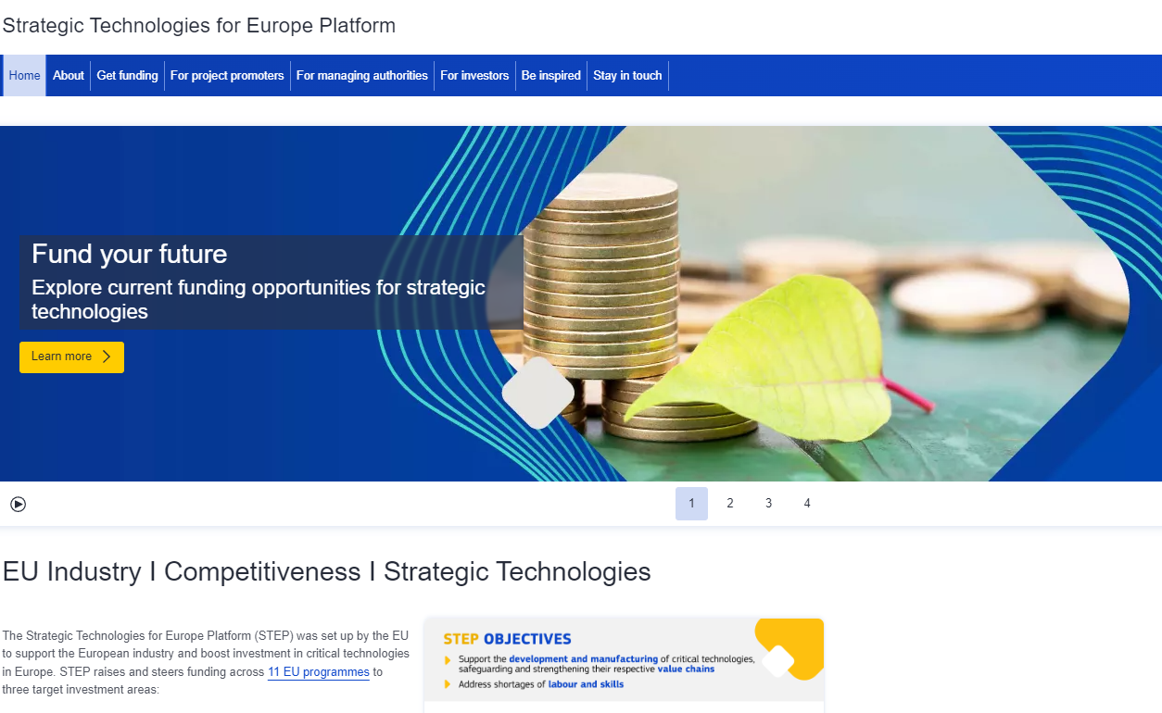
Portal : Central access point for users
STEP

Slide 19




Thank you
Contact us at EC-STEP-PARTNERS@ec.europa.eu
More info on STEP: strategic-technologies.europa.eu
STEP Guidance Note I and Guidance Note II
Defence mini-omnibus
STEP Seals Dashboard
STEP Newsletter

Slide 20
Annexes

Slide 21
STEP technology areas
List per sector (non-exhaustive)

Slide 22
Digital and deep technologies
STEP SECTORS
Advanced semiconductors technologies | Microelectronics, photonics, high frequency chips, semiconductors,etc.
Artificial intelligence technologies | AI algorithms, high performance computing, analytics technologies, etc.
Quantum technologies | Quantum computing, quantum key distribution, quantum simulation, quantum imaging, etc.
Advanced connectivity, navigation, and digital technologies | Secure digital communications and connectivity, such as RAN (Radio Access Network) & Open RAN (Radio Access Network), and 5G and 6G; cyber security technologies including cyber- surveillance, security and intrusion systems, digital forensics, etc.
Advanced sensing technologies | Electro-optical, radar, chemical, biological, radiation and distributed sensing;, etc.
Robotics and autonomous systems | Autonomous habited and uninhabited vehicles (space, air, land, surface, and underwater), including swarming; robots and robot-controlled precision systems, etc.

Slide 23
Clean and resource efficient technologies 1/2
STEP SECTORS
Solar technologies | Solar photovoltaic technologies; solar thermal electric technologies; solar thermal technologies; other solar technologies
Onshore wind and offshore renewable technologies | Onshore wind technologies; offshore renewable technologies
Battery and energy strorage technologies | Battery technologies; energy storage technologies
Heat pumps and geothermal energy technologies | Heat pump technologies; geothermal energy technologies
Hydrogen technologies | Electrolysers; hydrogen fuel cells; other hydrogen technologies
Sustainable biogas and biomethane technologies | Sustainable biogas technologies; sustainable bio-methane technologies
Carbon capture and storage technologies | Carbon capture technologies; carbon storage technologies
Electricity grid technologies | Electricity grid technologies; electric charging technologies for transportation; technologies to digitalise the grid; other electricity grid technologies
Nuclear fission technologies | Nuclear fission energy technologies; nuclear fuel cycle technologies
Sustainable alternative fuels technologies | Sustainable alternative fuels technologies

Slide 24
Clean and resource efficient technologies 2/2
STEP SECTORS
Hydropower technologies | Hydropower technologies
Other renewable energy technologies | Osmotic energy technologies; ambient energy technologies, other than heat pumps; biomass technologies; landfill gas technologies; other renewable energy technologies, etc.
Energy system-related energy efficiency technologies | Energy system-related energy efficiency technologies; heat grid technologies; other energy system-related energy efficiency technologies
Renewable fuels of non-biological origin technologies | Renewable fuels of non-biological origin technologies
Biotech climate and energy solutions | Biotech climate and energy solutions
Transformative industrial technologies for decarbonisation | Transformative industrial technologies for decarbonisation
CO2 transport and utilisation technologies | CO2 transport technologies; CO2 utilisation technologies
Wind and electric propulsion technologies for transportation | Wind propulsion technologies; electric propulsion technologies
Other nuclear technologies | Other nuclear technologies
Advanced materials, manufacturing and recycling technologies | Technologies for nanomaterials; smart materials; advanced ceramic materials; stealth materials; safe and sustainable by design materials; etc.
Technologies vital to sustainability such as water purification and desalination | Purification and desalination technologies
Circular economy technologies | Technologies for the reuse and recycling of electronics (e-waste); circular bioeconomy technologies

Slide 25
Biotechnologies
STEP SECTORS
DNA/RNA | Genomics; pharmacogenomics; gene probes; genetic engineering; DNA/RNA sequencing/synthesis/amplification; gene expression profiling,etc.
Proteins and other molecules | Sequencing/synthesis/engineering/manufacturing of proteins and peptides (including large molecule hormones); improved delivery methods for large molecule drugs, etc.
Cell and tissue culture and engineering | Cell/tissue culture; tissue engineering; cellular fusion; marker assisted breeding technologies; etc.
Process biotechnology techniques | Fermentation using bioreactors; biorefining; bioprocessing; bioleaching; biopulping; biobleaching; biodesulphurisation; bioremediation; biosensing; biofiltration and phytoremediation; molecular aquaculture; etc.
Gene and RNA vectors | Gene therapy; viral vectors
Bioinformatics | Construction of databases on genomes; protein sequences; modelling complex biological processes; including systems biology; etc.
Nanobiotechnology | Application of the tools and processes of nano/microfabrication to build devices for studying biosystems and applications in drug delivery, diagnostics, manufacturing, etc.

Slide 26
Defence technologies
STEP SECTORS
Air and missile defence | Integrated multi-layered air and missile defence systems, interceptors, detection systems (radars)
Artillery and precision strike | Artillery systems, long-range precision strike, advanced munitions
Missiles and ammunition | Guided missiles and ammunition, conventional munitions, warheads, propellants
Drones and counter-drones | UAVs (all classes), swarming systems, jammers, anti-UAV systems
Strategic enablers | Space assets and their protection, space situational awareness, space-based services such as Earth Observation, PNT and secure communications, critical infrastructure protection, energy security
Cyber, AI and electronic warfare | AI for command and control, cyber-defence, information warfare, electromagnetic spectrum operations, including electronic warfare suites, digital transformation of armed forces, optronics and radiofrequency systems
Military mobility | Warehousing and engineering capabilities, sustainable and agile logistics, additive manufacturing for combat maintenance
Ground combat | Close fire support systems, soldier systems, manned and unmanned ground systems
Maritime | Maritime situational awareness, surface and underwater combat manned and unmanned systems, seabed and anti-submarine warfare systems
Air combat | Air combat systems, airborne early warning, tactical and strategic air transport systems, rotorcraft, air-to-air refuelling
Medical (incl. countermeasures) | CBRN warfare including dedicated sensors and protective, decontamination and recovery systems

Slide 27
STEP project examples

Slide 28
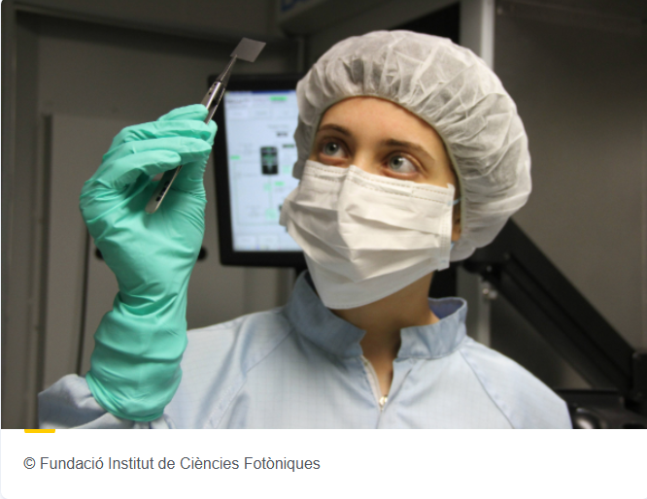

STEP Stories – digital and deep tech (ERDF)
PhotonChip: Covering the whole value chain of photonic technologies
PhotonChip is a platform project that will help bring photonic technologies, in particular integrated photonics and photonic chips, from scientific feasibility to prototype stage to be applied in, for instance, communications as 6G transceivers, sensors, quantum computing and technology platforms.
Catalonia, Spain

Slide 29
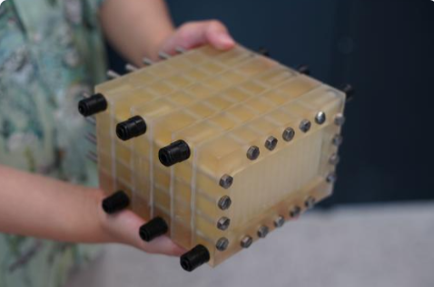
STEP Stories – clean/resource efficient tech (JTF)
FiBrane: Research project for offshore Green H2 Production
FiBrane is a groundbreaking method for efficiently transforming seawater into ultrapure water (UPW) needed for offshore green hydrogen production.
Denmark

Slide 30
STEP Stories – biotechnologies (EU4Health)
RoboPharma - Agile Pharmaceutical Manufacturing
AI to strengthen our medicine supply chain - This project develops an AI and robotic driven, decentralised pharmaceutical EU manufacturing platform to enhance crisis preparedness.
Italy

Slide 31
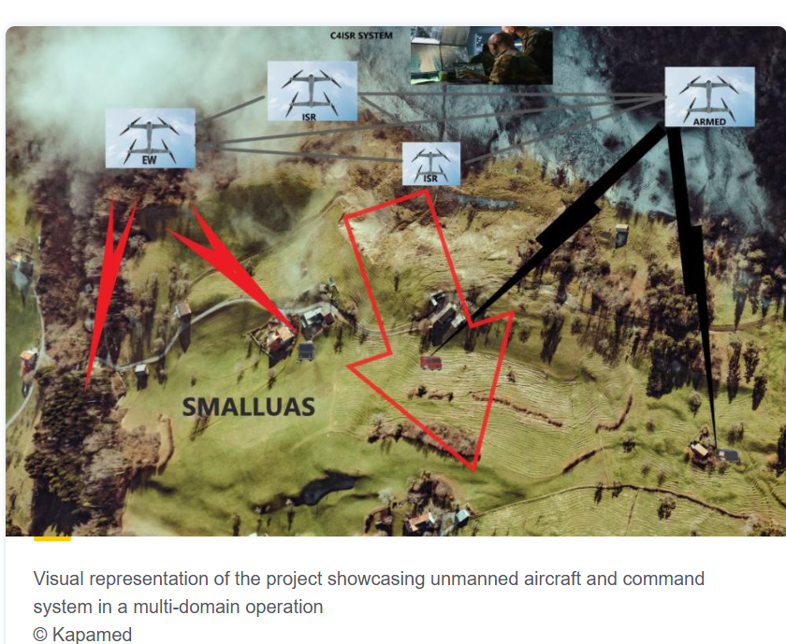
STEP Stories – defence technologies (EDF)
Defence: small, hard-to-detect aircraft for autonomous missions
The Small UAS project encompasses an advanced AI-driven group system of 10 unmanned aerial systems (hence the acronym UAS), specifically designed for operations in air, land, and maritime environments.
Romania - Cyprus - Slovenia - Lithuania - Netherlands - Ukraine - Austria - Greece

Slide 32
STEP scope - additional info

Slide 33




Common misunderstandings on STEP scope
STEP
Deployment of existing technologies instead of the development or manufacturing
Actions on fundamental research and whose feasibility has not been tested
Equipment and infrastructure with no criticality/specificity to a STEP sector or not listed as associated service
Skills related to the sectors and not to the development of technologies
Notes:
3 Common mistakes: deployment, associated services, fundamental research. On top of it, skills linked to the sectors and not to the technologies.
Associated services - pay attention to the use – predominantly for STEP purposes.

